Slide 1
Linear Regression Model on Airbnb Pricing for Clark County Nevada

Slide 2


Heidi Petersen
Graduate from Utah State University Bachelor of Science- Mathematics
Current student at Western Governors University in Master of Science- Data Analytics

Slide 3
Goal of Study: Create an equation to accurately price Airbnb rentals

Slide 4
Tourism is a vital source of Clark County’s economy

Slide 5
Results of Study The ability to properly price and anticipate future pricing of rentals will contribute to residents continuing to support the yearly tourism lodging needs.

Slide 6
Inside Airbnb tracks Airbnb data for public use
Clark County had 8,903 rental listings
74 Pieces of information about each listing

Slide 7
Obstacles to Creating model
Empty cells. 76,528 out of 658,822 had missing values.
The price, bed, bedrooms, and bathrooms had to be adjusted by number of guests to make the data more homogeneous.
Abundance of factors to consider: 74 for each listing

Slide 8
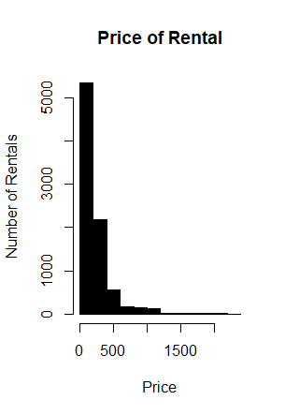
Prices ranged from $14 per night for a private room and shared bath to tens of thousands of dollars for more luxurious accommodations.

Slide 9
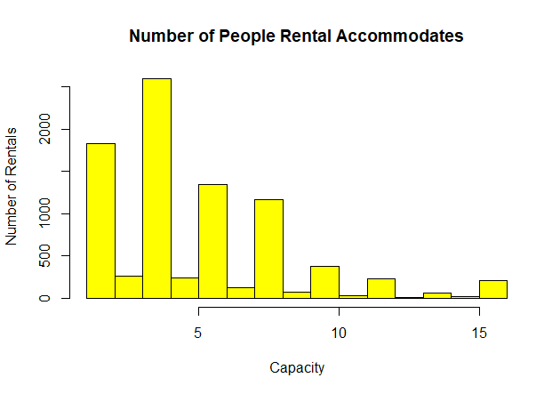
Rentals accommodate ranging from 1 guest to 16 guests

Slide 10
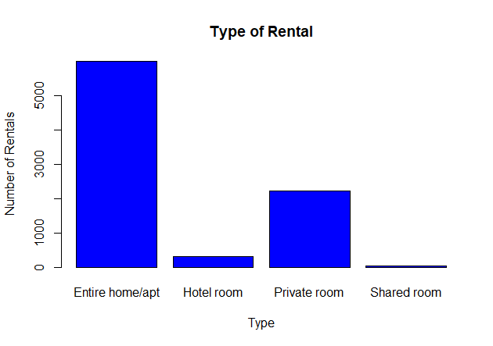
Most rentals were for the entire house but some had shared accommodations.

Slide 11
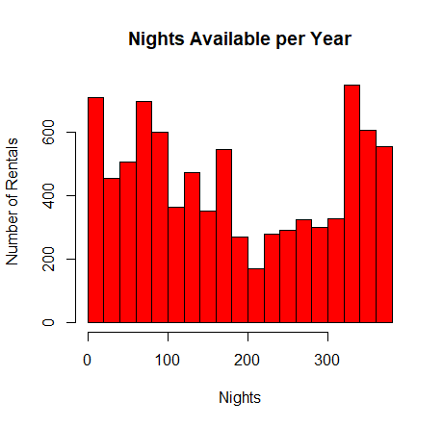
Rentals were available for variable number of nights per year

Slide 12
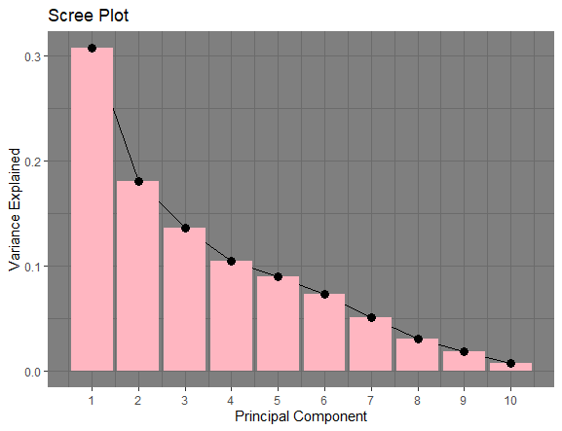
Primary Component Analysis

Slide 13
1. PCA to narrow focus on variables 2. Variables with no predictive power and those highly correlated with others were dropped.
Reduction of variables

Slide 14
Final Equation
Price_per_guest ≈ 33.6897 +22.0998X₁ – 10.6294X₂ + 0.0837X₃– 0.4084X₄
X1=Number of Beds per guest
X2=Entire Rental
X3=Number of nights available per year
X4=Minimum required night stay
Linear Model can be used to price Airbnb rentals in Clark County

Slide 15
Limitations of Study
There is only limited data on the rentals.
The study examines more of a snapshot of the rental details and availability and not how their price has changed over time.
This study includes Clark County, Nevada instead of a larger sample of cities. Partly this choice is to focus on an area where tourism is the biggest portion of the economy: Las Vegas and the surrounding areas.
This study does not include anything related to reviews as it is focused on early parts of the process contributing to pricing.
Pictures and host demographic information may have influence on the price, but this study is restricted to more quantifiable measurements.

Slide 16

How rental prices and factors change over time Other factors that are harder to quantify Comparison to other counties and cities City versus unincorporated areas of Clark County
Further
Analysis

Slide 17
Sources
"Company Overview of Airbnb, Inc". Bloomberg L.P. January 7, 2018. Archived from the original on January 8, 2018. Retrieved August 21, 2021 from https://www.bloomberg.com/research/stocks/private/snapshot.asp?privcapId=115705393.
Cox, Murray. 2014. Inside Airbnb. Retrieved August 21, 2021 from http://insideAirbnb.com/.
Gustafsson, Alexander, and Sebastian Wogenius. Modelling Apartment Prices with the Multiple Linear Regression Model. Royal Institute of Technology School of Engineering Sciences, 2014, https://www.divaportal.org/smash/get/diva2:725045/FULLTEXT01.pdfMultiple.
R advantages and disadvantages. www.javatpoint.com. (n.d.). Retrieved October 26, 2021, from https://www.javatpoint.com/r-advantages-and-disadvantages .
University of Nevada-Las Vegas (UNLV) Center for Business and Economic Research. (2021). “Southern Nevada Economy” [Webpage]. Retrieved from https://cber.unlv.edu/SNBDI/economy.html .

